Slide 1

Create Multi-Platform Apps w/ .NET MAUI & the MAUI Toolkit
Alvin Ashcraft
Sr. Content Developer
Microsoft
Level: Intermediate

Slide 2

Session Survey
Your feedback is very important to us
Please take a moment to complete the session survey found in the mobile app
Use the QR code or search for “Converge360 Events” in your app store
Find this session on the Agenda tab
Click “Session Evaluation”
Thank you!

Slide 3
Agenda
About Me
Introduction to .NET MAUI and Cross-Platform Apps
Develop on Windows and macOS
Rapid App Building with XAML, C# & Visual Studio
Enhance Apps with the .NET MAUI Community Toolkit
Simplify Your MVVM Architecture with the MVVM Toolkit
Build Apps with C# Markup in VS Code: No XAML Required
Style Apps with CSS
Access Platform-Specific Features
Foundry Local models on Windows & Android (time permitting)
Q&A

Slide 4
About me
Sr. Content Dev on Microsoft Learn
Azure OpenAI docs on Microsoft Foundry
Software industry for 30+ years
Morning Dew link blog (alvinashcraft.com)
Three books for Packt Publishing
TechBash dev conference organizers since 2016

Slide 5
Overview of MAUI & Supported Platforms
Multi-platform Framework
.NET MAUI allows building apps for multiple platforms w/ a single shared codebase.
Supported Platforms
Windows & macOS on desktop and iOS & Android mobile devices, enabling cross-device compatibility for most app users today.

Slide 6
Benefits of a single codebase
Reduced maintenance
A single codebase simplifies updates and bug fixes, lowering the time and resources needed for maintenance.
Faster development
Developers can build and deploy features faster by writing code once for all platforms.
Consistent user experience
Using a unified codebase ensures users enjoy the same experience across devices and operating systems while still providing native performance and look & feel.

Slide 7
.NET MAUI vs other frameworks
Language
Ideal choice for .NET developers. Frameworks like Flutter and React Native require other technical expertise.
Enhanced Performance
Enables faster and more efficient app execution compared to PWAs or React Native.
Community and Ecosystem
Puts Microsoft in your corner. 3rd party libraries & controls are available but not required for building rich, performant apps. The .NET MAUI Community Toolkit and .NET Community Toolkit offer additional libraries supported by the open-source community.

Slide 8
IDEs and Tools
Primary IDEs
Visual Studio on Windows and VS Code on Windows and macOS serve as the main development environments for .NET MAUI development.
Supporting Tools
VS Code, GitHub Copilot, and CLI tools complement the primary IDEs by supporting flexible and lightweight development workflows. .NET MAUI Community Toolkit offers open-source controls and helpers for your apps.
Additional Options
JetBrains Rider supports .NET MAUI development on Windows and macOS.

Slide 9
Build & Debug Across Platforms
Debugging Tools Usage
XAML Hot Reload
Live Visual Tree
Visual Studio’s Binding Failures window
Simulators and Emulators
Android & iOS
Real-time testing with or without physical devices
Connect to macOS from Visual Studio on Windows to debug iOS apps in the Simulators

Slide 10
Productivity Tips
Hot Reload Feature
XAML Hot Reload & .NET Hot Reload enable instant code and markup changes, speeding up development & reducing testing time.
Use of Templates
Templates provide reusable structures, enhancing consistency & saving time coding.
Extensions for Quality
Visual Studio & VS Code extensions add functionality & help maintain high code quality across platforms.

Slide 11
Build UIs with XAML or C#
XAML markup for clear & declarative UI design when building responsive UIs.
Code behind in C#
Separation of concerns with MVVM
Create UI in code with C# Markup
MVU pattern for robust apps
No XAML learning curve
Demo: .NET MAUI projects in Visual Studio

Slide 12
.NET MAUI Toolkit Overview
Reusable UI Components
Microsoft’s Community Toolkits provide reusable components that speed up UI development and maintain consistency.
Functionality Enhancements
Extensions, converters & animations add new features that extend the capabilities of existing UI elements.
Improved Responsiveness
Behaviors improve app responsiveness by managing user interactions smoothly.
Demo
Toolkit docs on Microsoft Learn
MAUI projects with Toolkit features

Slide 13
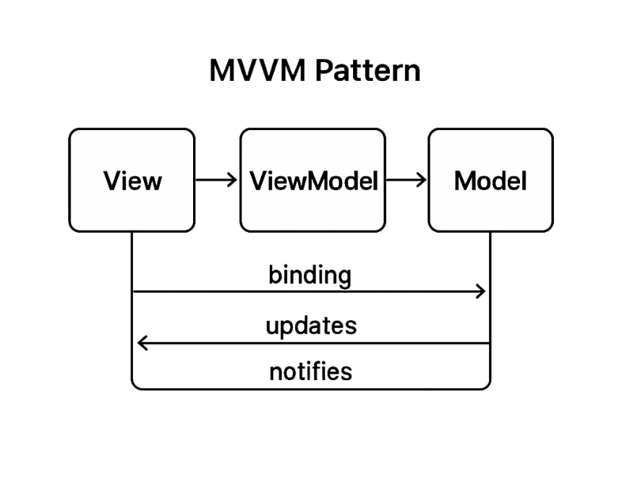
MVVM in MAUI apps
Separation of Concerns
MVVM separates UI from business logic for cleaner & modular code design.
Improved Code Organization
Using MVVM enhances code maintainability and organization in .NET MAUI applications.
Easier Testing
MVVM facilitates unit testing by isolating business logic from UI elements.

Slide 14
Reduce Boilerplate w/ MVVM Toolkit
Minimize repetitive code
Base classes designed to reduce repetitive coding tasks efficiently.
Streamline development
Helpers in the toolkit streamline the development process, enhancing productivity & maintainability.

Slide 15
Build Scalable Apps
Data Binding
Use data binding to synchronize UI and data models efficiently, enhancing app responsiveness and maintainability.
Command Patterns
Apply command patterns to encapsulate requests as objects, facilitating flexible and reusable code.
Dependency Injection
Use dependency injection to manage component dependencies, promoting modular and testable code architecture.
Messaging
Keep Views and View Models loosely coupled with pub/sub messaging.
Demo
Use the MVVM Toolkit in Your Project

Slide 16
C# Markup – No XAML!
Programmatic UI Creation
Create and modify user interface elements using C# markup programmatically.
Improved Code Reuse
Enhance code reuse by allowing modular UI components to be managed efficiently.
Reduced Context Switching
Using C# markup reduces context switching between design and code environments for developers.

Slide 17
Recommended Scenarios for C# Markup
Dynamic Layouts
Get flexible, dynamic layouts that adjust automatically based on data and user interactions.
Data-Driven UI Generation
UI elements can be generated dynamically from data sources, improving responsiveness and customization.
Demo
Create a Project w/ C# Markup

Slide 18
Reuse Web Skills w/ CSS in MAUI
Leverage Web Development Skills
Use your existing CSS dev knowledge to style .NET MAUI apps.
Save Development Time
Reuse web assets to reduce design time - accelerates app dev & deployment.
Maintain Brand Consistency
Consistent styling across web & MAUI apps ensures strong & uniform brand identity.

Slide 19
Foundry Local Models on Windows, macOS & Android
Command line install on Windows & macOS
winget install Microsoft.FoundryLocal
brew tap microsoft/foundrylocal && brew install foundrylocal
Install Foundry Local app on Android
Use Microsoft.AI.Foundry.Local nuget package in .NET MAUI
Use cached models for offline scenarios
Demo
Chat with a local model in .NET MAUI

Slide 20
Thank you!
Q&A
Questions about .NET MAUI & the Community Toolkits?
General Cross-Platform Dev Questions?
Feedback (QR code next slide)
Follow up later:
alashcraft@gmail.com
Find me on BlueSky & LinkedIn
Thank you!

Slide 21
Session Survey
Your feedback is very important to us
Please take a moment to complete the session survey found in the mobile app
Use the QR code or search for “Converge360 Events” in your app store
Find this session on the Agenda tab
Click “Session Evaluation”
Thank you!

